Slide 1

Overview
of the Health / Public Health
System of Georgia
NCDC Capacity
Amiran Gamkrelidze
MD, PhD, Professor
Director General
National Center for Disease Control & Public Health
www.ncdc.ge
Notes:
1

Slide 2
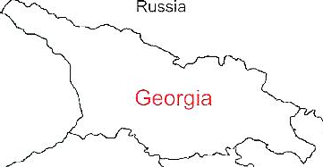
Demographic and Social-Economic situation, 2018
Population – 3 726 000
Birth rate (per thousand population) – 13.7
Mortality rate (per thousand population) – 12.5
Life expectancy at birth – 74.0
Maternal Mortality (per 100000 live birth) – 13.1 (2017)
Infant mortality (per 1000 live birth) – 8.1
Under 5 mortality rate (per 1000 live birth) – 9.8
GDP per capita – 4290.17 USD (2017)
GDP real growth – 4.7%
Government expenditure on health as % of GDP – 2.9% (2017)
Public health expenditure per capita (GEL) – 293 (2017)
Government expenditure on health as % of Total Health expenditure – 38% (2017)
National Center for Disease Control & Public Health
www.ncdc.ge

Slide 3
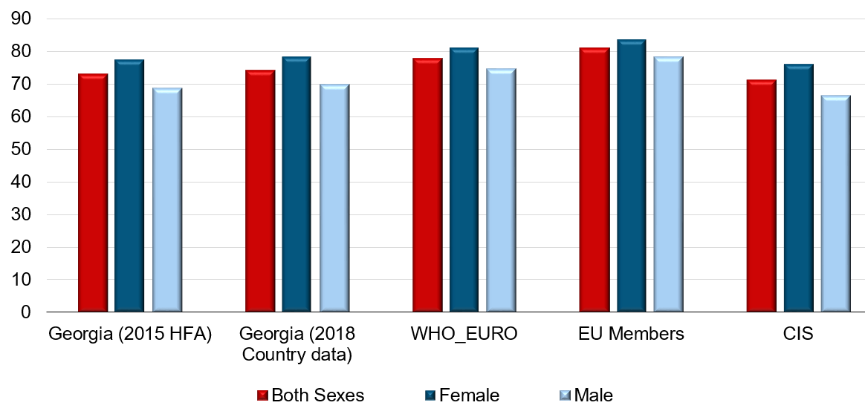
Life expectancy at birth (last available year)
Georgia, 2018
Total | 74.0
Male | 69.7
Female | 78.2
National Center for Disease Control & Public Health
www.ncdc.ge

Slide 4
Burden of diseases(DALYs), Georgia, 2016 (WHO estimation)
Source: WHO
National Center for Disease Control & Public Health
www.ncdc.ge

Slide 5
Mortality structure, Georgia, 2016
(WHO estimates)
Source: WHO
National Center for Disease Control & Public Health
www.ncdc.ge

Slide 6
Under-5 mortality rate per 1000 live births
National Center for Disease Control & Public Health
www.ncdc.ge

Slide 7
Infant mortality rate per 1000 live births
National Center for Disease Control & Public Health
www.ncdc.ge

Slide 8
Maternal mortality ratio per 100 000 live births
National Center for Disease Control & Public Health
www.ncdc.ge

Slide 9
Health Expenditures, Georgia
MoLHSA/NHA
National Center for Disease Control & Public Health
WHO-EURO/HFA
www.ncdc.ge

Slide 10
Structure of Total Spending on Healthcare
MoLHSA/NHA
National Center for Disease Control & Public Health
MoLHSA/NHA
www.ncdc.ge

Slide 11
Out-of-Pocket payment (OOP) as % of
Total Health Expenditure (THE)
National Center for Disease Control & Public Health
MoLHSA/NHA
www.ncdc.ge

Slide 12
Out-of-pocket payment share of total health spending
high in many countries
High- and middle-income countries in the European Region
WARNING
SAFE: < 15% with pro-poor policies
Source: WHO data for 2014
WHO-EURO
National Center for Disease Control & Public Health
www.ncdc.ge
Notes:
High-performing health systems provide strong financial protection to keep out-of-pocket payments to a minimum: that is at or below 15% of total health expenditures.
Many countries need to increase the share of public financing for health, together with stronger pro-poor policies.

Slide 13
Some Indicators of the Health system
 | EU Region, 2014 | EU-28, 2014 | Georgia, 2017
Number of hospital beds |  |  | 15569
Number of hospital beds per 100000 population | 553.9 | 521.6 | 417.8
Hospital admissions rate per 100 population | 17.9 | 17.3 | 13.5
Bed occupancy rate | 86.7% | 77.0% | 52%
Average length of stay | 8.7 | 8.2 | 5.9
Number of In-patient facilities |  |  | 258
Number of In-patient facilities per 100000 population | 3.09 | 2.91 | 6.9
Number of out-patient facilities |  |  | 1008
Rural physician-entrepreneurs |  |  | 1265
Numbers of encounters of the population with outpatient facilities per capita | 7.6 | 7.0 | 3.0
Number of physicians |  |  | 30910
Physicians per 100000 population | 322.3 | 349.6 | 829.5
Number of nurses |  |  | 17862
Nurses per 100000 population | 740.4 | 864.3 | 509.0
National Center for Disease Control & Public Health
www.ncdc.ge

Slide 14
Health Priority Directions for 2014-2020
Health in all policies – general state multi-sectoral approach
Development of the healthcare sector governance
Improvement of healthcare financing system
Development of quality medical services
Development of human resources in the healthcare sector
Development of health management information systems
Support of maternal and child health
Improvement of prevention and management of priority communicable diseases
Improvement of prevention and control of priority non-communicable diseases
Development of public health system
National Center for Disease Control & Public Health
www.ncdc.ge

Slide 15
Organizational Structure of Healthcare, 2018
President
Cabinet of Ministers
Parliament
Ministry of Economy and Sustainable Development
Ministry of Internally Displaced Persons from the Occupied Territories, Labour, Health and Social Affairs
Ministry of Finance
Ministry of Education, Science, Culture and Sport
Other Ministries
National Center for Disease Control and Public Health
Medical University
Parallel structures of Healthcare
Local Government
Emergency Medical Assistance Center
Scientific Research Institutions
Public Health Services
Social Service Agency
Private Medical Insurance Companies
Primary Healthcare Private Providers
State Primary Healthcare Providers
Private Hospitals
Public Hospitals
Patient / population
Pharmacies
National Center for Disease Control & Public Health
www.ncdc.ge

Slide 16
History of Development Medical Care Service Delivery in Georgia
Effort to establish balanced healthcare system based on PPP principle
Since 2013
Liberal
2005-2012
De-centralized
1994-2004
Centralized
(Soviet Period)
1921-1991
National Center for Disease Control & Public Health
www.ncdc.ge

Slide 17
Population Coverage Schemes
Universal Healthcare Program
Medical Insurance Program (Pilot in Tbilisi and Imereti region) for people under poverty line
Medical insurance program for population under the poverty line (whole country)
Voluntary insurance
for population from
3-to 60 age; children without care; compactly settled IDPs
0-5 Children, pensioners, disabled children
Public artists,
Rustaveli Prize Winners, teachers
2013
2012
2009
2008
2007
Mandatory medical contribution
2005
Healthcare system based mostly on taxes
2002
Mandatory medical insurance (3%+1%) program financing
1995-97
National Center for Disease Control & Public Health
www.ncdc.ge

Slide 18
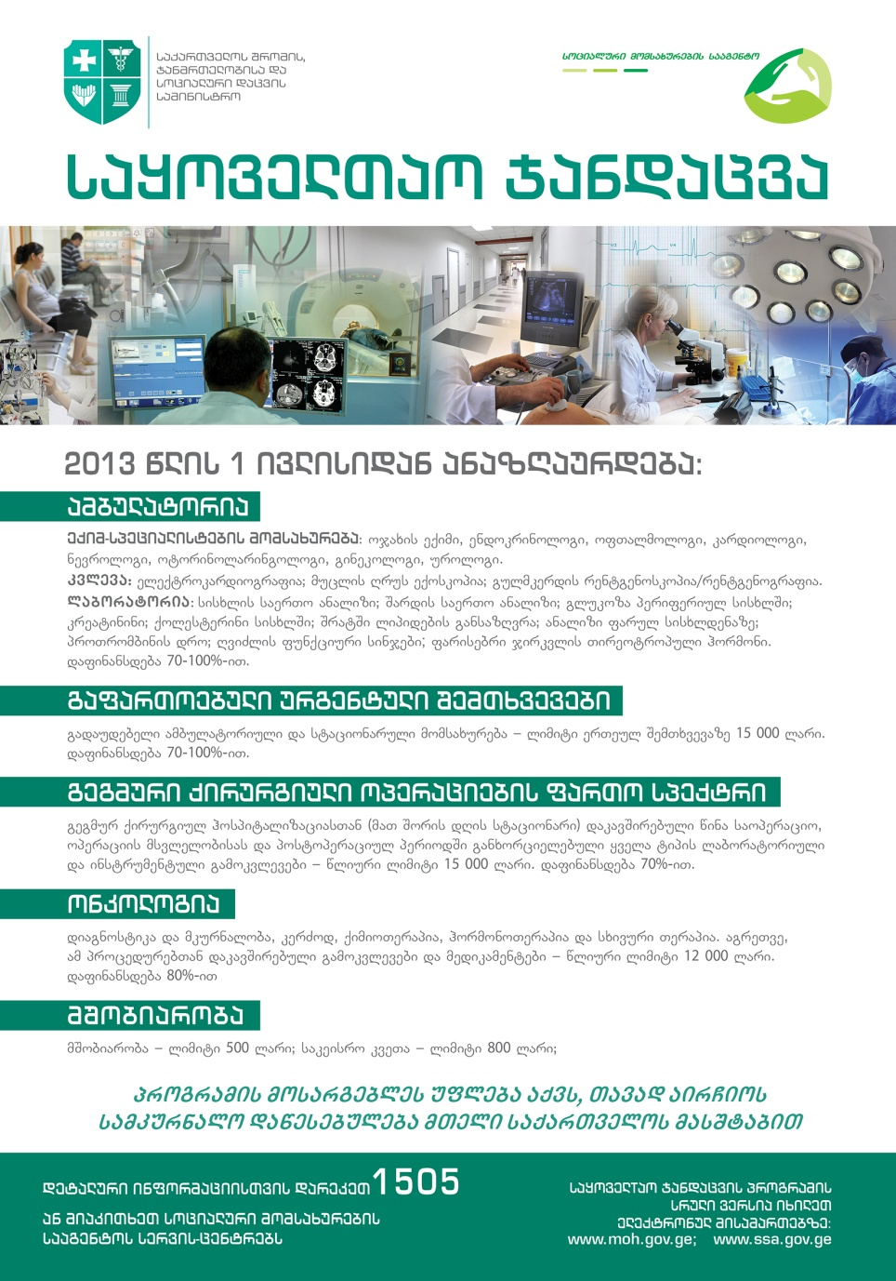
Universal Health Care –
Socially Oriented Political Platform
Unprecedented Expansion of State Budget for Health care:
365 mln GEL in 2012 → 1209 mln GEL in 2019
All population are covered by Health care:
  203 535 – Only Private/corporate insurance
  227 496 – State Health Insurance (Staff of Ministry of Internal Affairs and Ministry of Defense)
  Other population - UHC
National Center for Disease Control & Public Health
www.ncdc.ge

Slide 19
Coverage of Healthcare services
Services utilization
Hospitalization per 100 population
  UHC Program has led to a major expansion in population entitlement to publicly financed health services (HUES)
Ambulatory care visits per person per years
National Center for Disease Control & Public Health
www.ncdc.ge

Slide 20
“Vertical” State Health Programs
Public health programs
Early Detection and screening of Diseases
Immunization
Epidsurveillance
Blood safety
Prevention of occupational diseases
Management Infectious diseases
Management of TB
Management of HIV
Management of Hep C
Treatment of drug abuse
Maternal and Child health
Health promotion
Health services in priorities areas
Mental Health
Management of Diabetes
Child onco-hematology
Dialysis and kidney transplantation
Palliative care of incurable patients
Treatment of rare diseases
Ambulance and emergency care
Rural doctors
Medical screening for army recruits
Referral (individual care)
National Center for Disease Control & Public Health
www.ncdc.ge

Slide 21
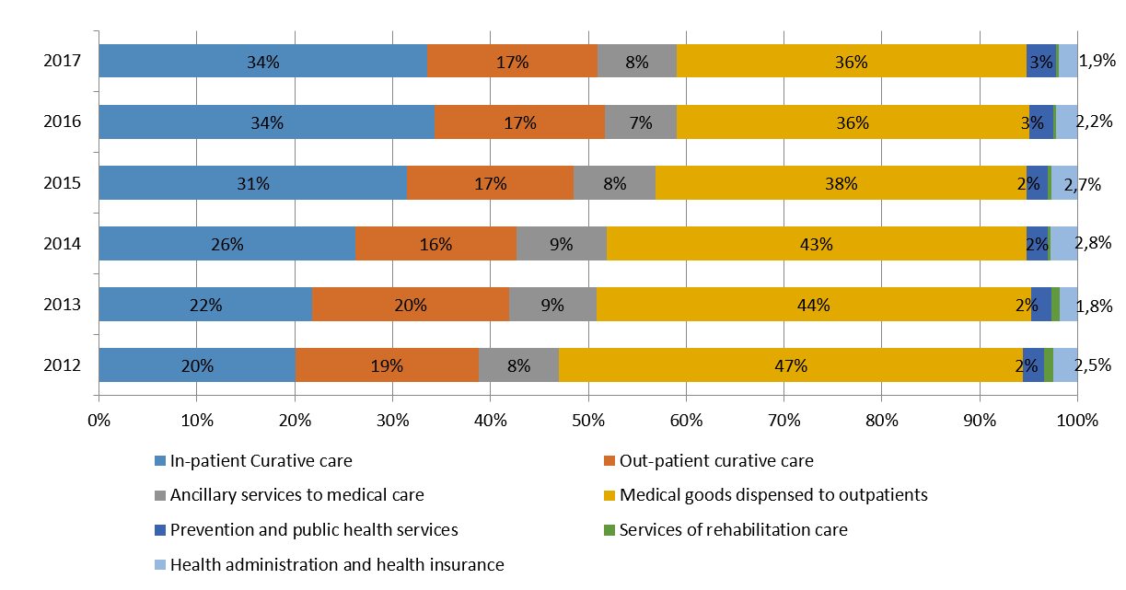
Total Health Expenditure distribution by functions
National Center for Disease Control & Public Health
www.ncdc.ge

Slide 22
Reforms have moved Georgia closer
to the best practice in Europe
Coverage policy
System architecture
Near-universal access to publicly financed care
Access to expensive, life-saving treatment
Free family doctor visits
A single purchasing agency pooling funds
Increased reliance on public funding
Public funding from the state budget
National Center for Disease Control & Public Health
www.ncdc.ge

Slide 23
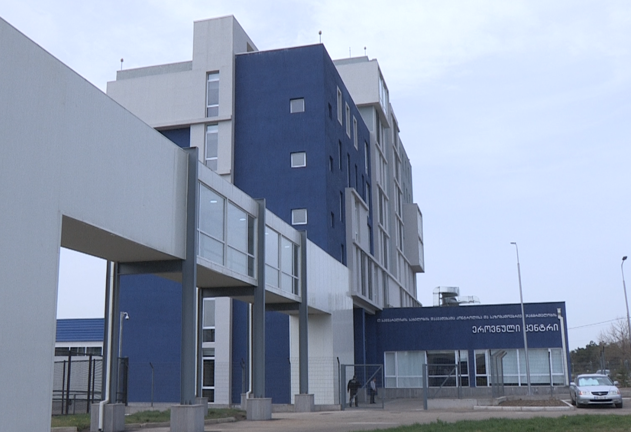
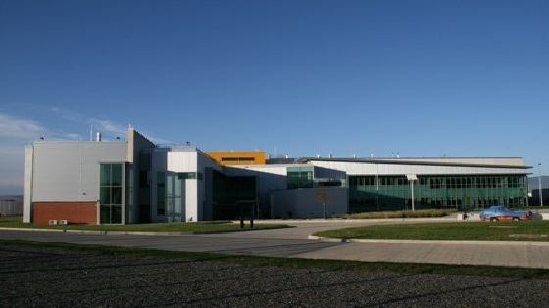
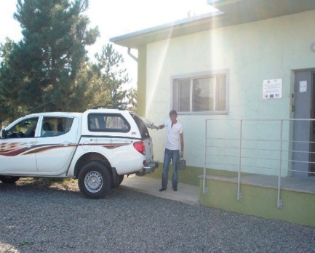
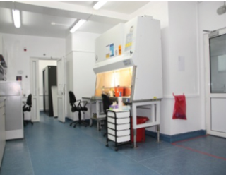
Current Public Health System
Central level: National Center for Disease Control & Public Health
and its 9 regional branches
Local level: Municipal public health centers under the local
governments
General responsibilities:
  Security & monitoring of epidemiological situation in the
  country
  Early detection and prevention of the diseases
  Information support
  Prevention of public health emergency situations and timely
  response
  Prevention of environmental hazards and
  behavioral risk-factors
  Development of applied and fundamental bio-medical
  scientific researches in Public health
National Center for Disease Control & Public Health
www.ncdc.ge
Notes:
23

Slide 24
Responses on Significant Challenges
Birth registry
CCHF
Malaria
elimination
Amebiasis
Diphtheria outbreak
Immunization process
Cancer registry
National Strategy of Tobacco control
2016
2014
2015
2013
Zero incidence rate of rabies in humans
Hepatitis C elimination program
2004 & 2013 & 2018-2019
Measles
outbreaks
Integration of the Lugar Center
2010
1998-1999
2007
Health Promotion State Program
2002
IHR
Polio
free
1993-1997
National Center for Disease Control & Public Health
www.ncdc.ge
Notes:
24

Slide 25
Public Health System Development in Georgia
Integration of the PH Department into the NCDC
Law on PH
Law on Health Care
Abolition of Sanitary Code and Sanitary-Epidemiological system
2007
Integration of the Center of Medical Statistics into the NCDC
2006
2003
The functions has been delegated to the 3 Ministries
1997
Sanitary Code
Ministry of
Health
1996
Establishment of the National Center for Disease Control (NCDC)
Ministry of
Agriculture
1994-1996
Ministry of Environment
Health system reform started: sanitary control & epidesurveillance
Before1994
State Department on Sanitary Supervision and Hygienic Normation
Soviet PH system (Sanitary-epidemiological service)
Public Health Department
National Center for Disease Control & Public Health
www.ncdc.ge
Notes:
25

Slide 26
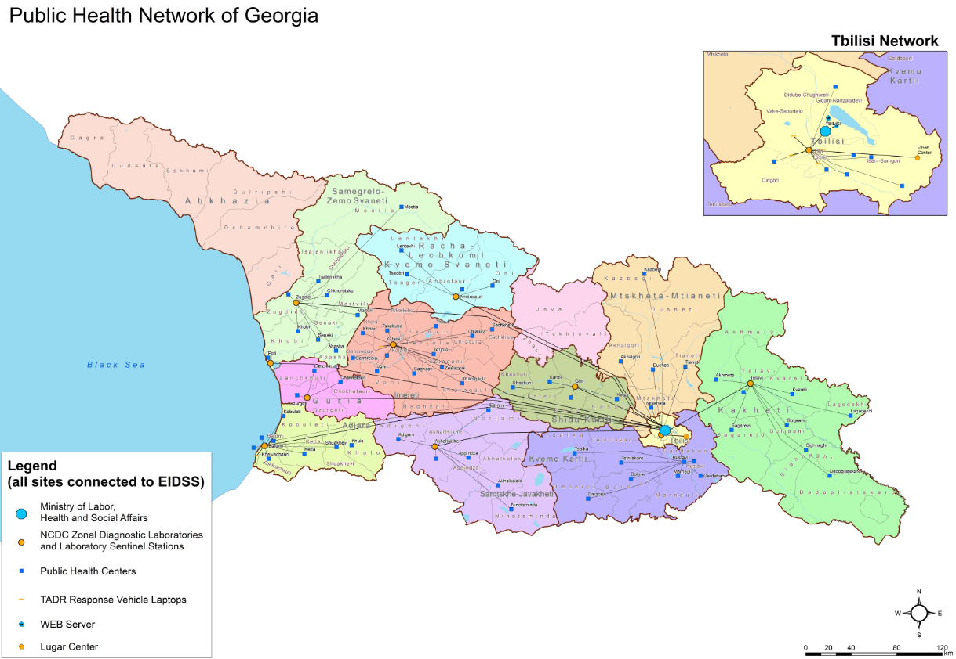
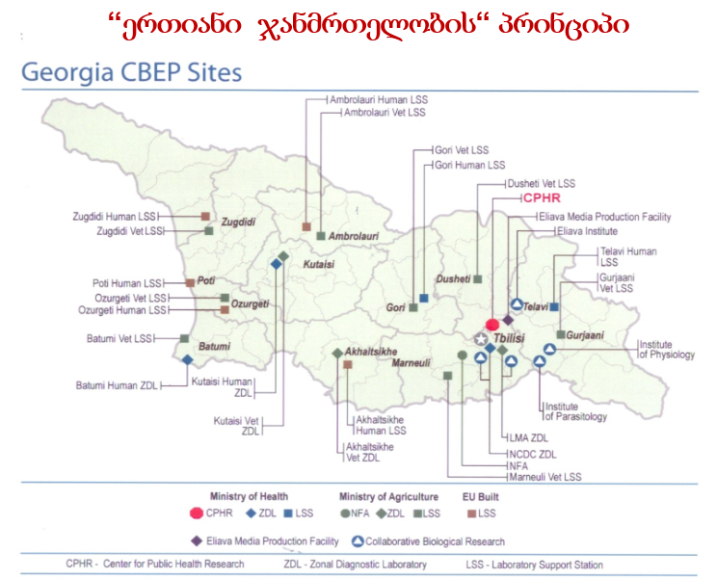
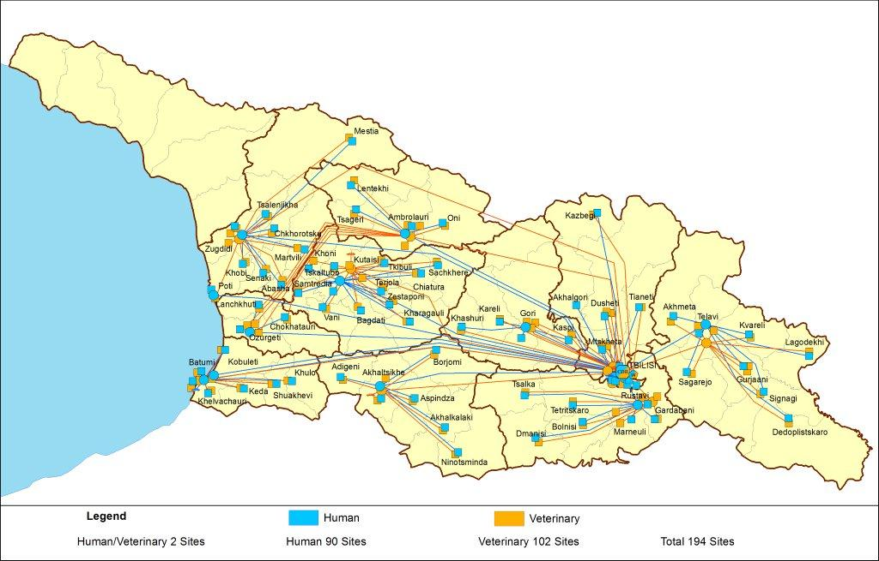
Unified Laboratory Network
Public Health Network
One Health
Electronic Integrated Disease Surveillance System (EIDSS)
72 notifiable diseases
200 entry points
61 territorial units
1020 personnel
National Center for Disease Control & Public Health
www.ncdc.ge
Notes:
26

Slide 27
New vaccine introduction 2002 -2017
Vaccine | 2002 | 2003 | 2010 | 2011 | 2012 | 2013 | 2014 | 2015 | 2016 | 2017
HepB mono
MMR
Penta
Rotavirus
Pneumo
HPV
Full Schedule: BCG, Hexa, HepB (Pediatric), MMR, bOPV, Pneumo, Rotavirus, Td, DPwT, Dt
National Center for Disease Control & Public Health
www.ncdc.ge

Slide 28
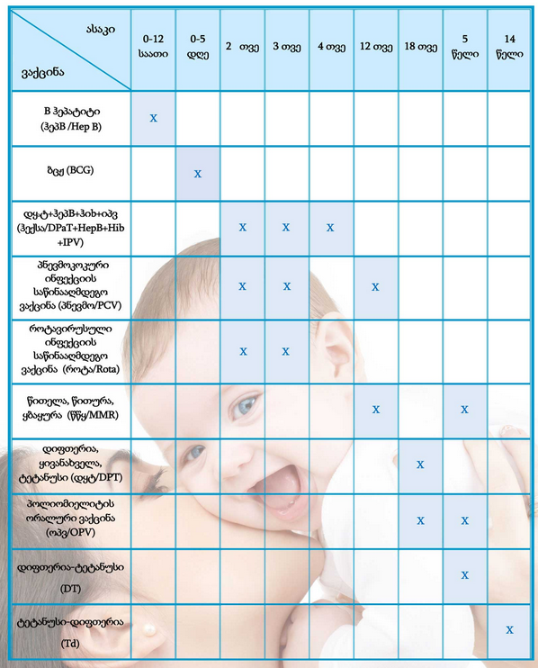
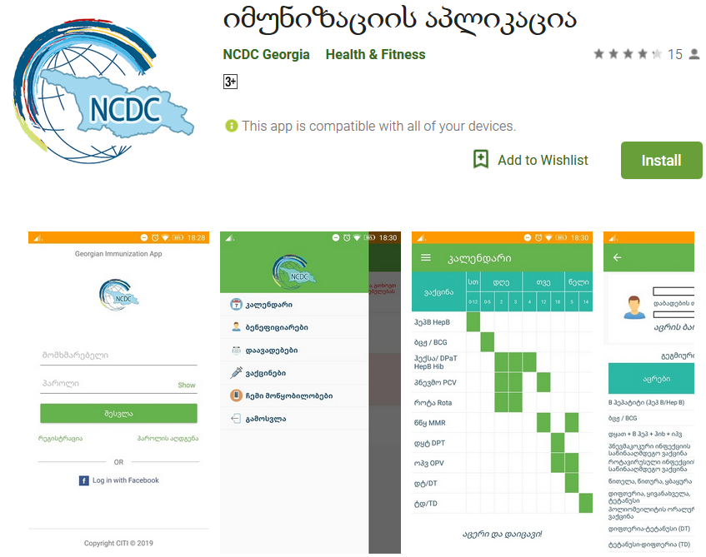
NIP achievements
Vaccination Schedule
Vaccination coverage
Immunization Program Budget (thousand GEL)
National Center for Disease Control & Public Health
www.ncdc.ge
Notes:
28

Slide 29
Diseases of Elimination Concern
Hepatitis C
Surveillance on Hepatitis C was established in 1996
Screening protocol as well as standard case definitions were developed
Specialist of Public Health Centers were trained on topics concerning Hepatitis C
By the means of the Sanford Guide, the application for hepatitis C treatment was developed
EMTCT of HIV and syphilis
Amendments were made to the National program for supporting the Elimination of mother-to-child transmission (EMTCT)
Measles-Rubella
Guideline on surveillance of Measles and Rubella was developed
Poliomyelitis
Georgia is certified as a country free from the wild poliomyelitis virus in 2002
IPV vaccination was introduced in country.
Surveillance on acute flaccid paralysis cases was actively implemented.
Malaria
No local case of malaria was recorded in 2016. Surveillance was established on 18 suspected cases, out of which 7 cases were confirmed (imported).
National Center for Disease Control and Public Health
www.ncdc.ge

Slide 30

Targets
Hepatitis C Elimination Program in Georgia
Goal
Elimination of HCV by ensuring prevention, diagnostics and treatment of the disease
90-95-95
Initiated treatment 56 318
Completed treatment 52, 053
By 2020
90% of people living with HCV are diagnosed
95% of those diagnosed are treated
95% of those treated are cured
Overall cure rate - 98.3%
(April 2019)
დაავადებათა კონტროლისა და საზოგადოებრივი ჯანმრთელობის ეროვნული ცენტრი
დაავადებათა კონტროლისა და საზოგადოებრივი ჯანმრთელობის ეროვნული ცენტრი
National Center for Disease Control & Public Health
www.ncdc.ge
www.ncdc.ge
www.ncdc.ge

Slide 31
HCV Screening among Georgian Population
Since 2015, over 2 million screenings have been registered in the Unified Screening Registry
≈1,3 million individuals have been screened with positivity rate – 9%
National Center for Disease Control and Public Health
დაავადებათა კონტროლისა და საზოგადოებრივი ჯანმრთელობის ეროვნული ცენტრი
დაავადებათა კონტროლისა და საზოგადოებრივი ჯანმრთელობის ეროვნული ცენტრი
National Center for Disease Control & Public Health
www.ncdc.ge
www.ncdc.ge
www.ncdc.ge
Notes:
NCDC is responsible on screening activities in the country.

Slide 32











Partnership in Hepatitis C Elimination Program
HCV Elimination Program Providers
TAG Members
National Center for Disease Control & Public Health

Slide 33
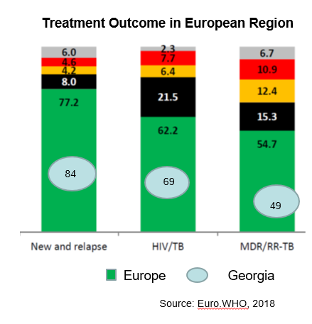
Tuberculosis
TB case notification in absolute numbers, Georgia
National Center for Disease Control & Public Health
www.ncdc.ge

Slide 34
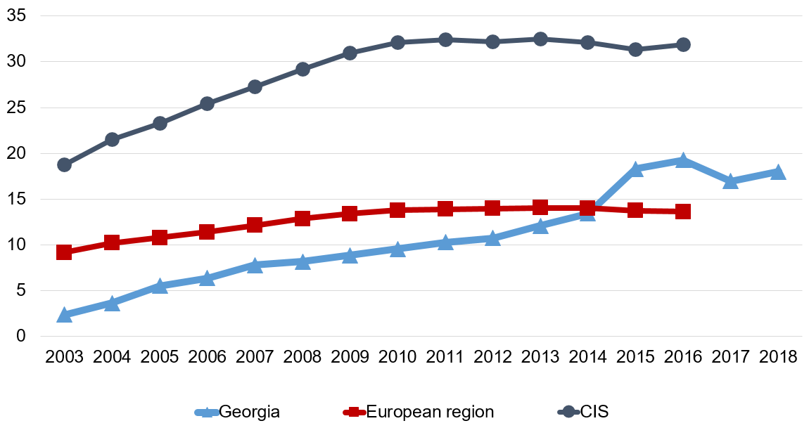
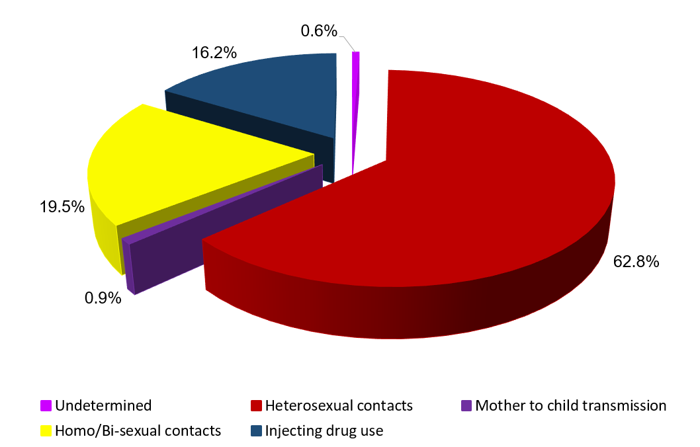
HIV/AIDS
HIV incidence per 100000 population
Distribution of Newly Diagnosed HIV Cases by Routs of Transmission
2008 - National HIV/AIDS Surveillance Plan for Georgia was elaborated
2010 - Guidelines for HIV/AIDS surveillance were developed
Estimated number of PLHIV – 9,360
Registered number alive – 6,024
Main Challenge: Late case detection
2018 - 672 new cases of HIV (incidence per 100,000 population – 18.0)
Universal access to retroviral treatment in Georgia is at place
4310 persons are under the ART (Q1, 2018)
Source: Infectious Diseases, AIDS and Clinical Immunology Research Center
National Center for Disease Control & Public Health
www.ncdc.ge

Slide 35
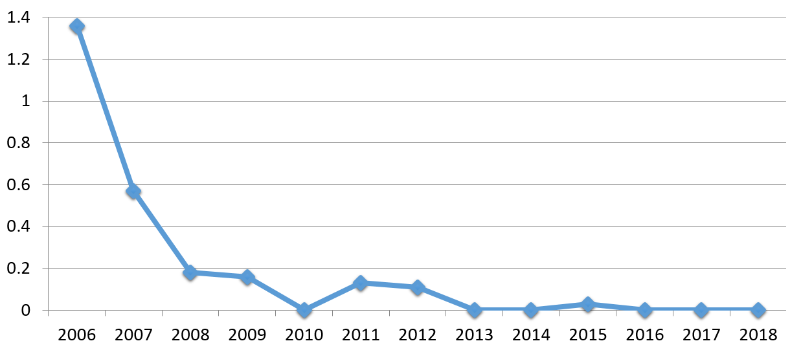
Malaria
Georgia became the first country in the European region granted by the Global Fund for Malaria. As a result of the Project, consistent reduction of malaria cases have been achieved in the country since 2004.
Registered 472 cases decreased to 1 from 2002 to 2009.
Malaria as an endemic disease in Georgia has been eliminated since 2010.
Incidence of malaria per 100000 population Georgia
National Center for Disease Control & Public Health
www.ncdc.ge

Slide 36
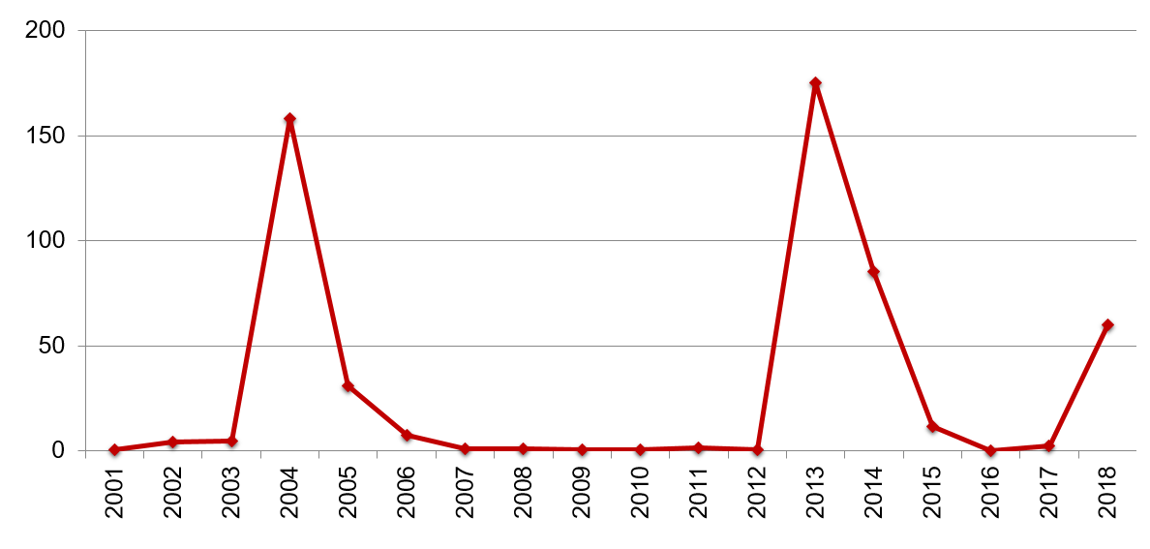
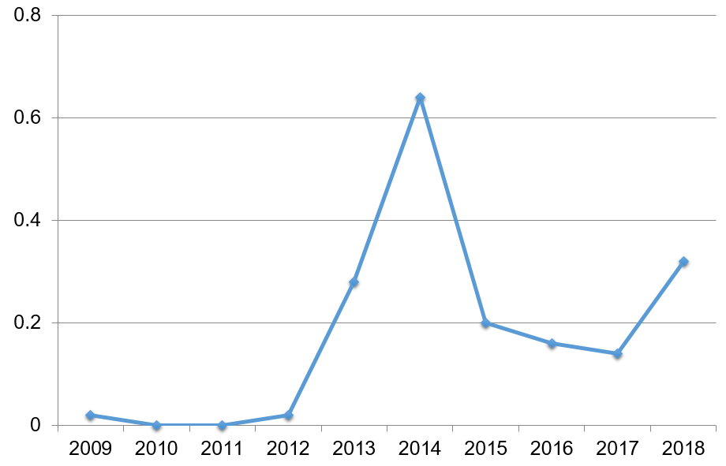
Incidence of Measles per 100000 population
Measles
In 2018, 2200 cases were registered
Crimean-Congo Hemorrhagic Fever Incidence per 100000 population
Crimean-Congo Hemorrhagic Fever
In 2018 12 cases of CCHF were registered, one of them was fatal
National Center for Disease Control & Public Health
www.ncdc.ge

Slide 37
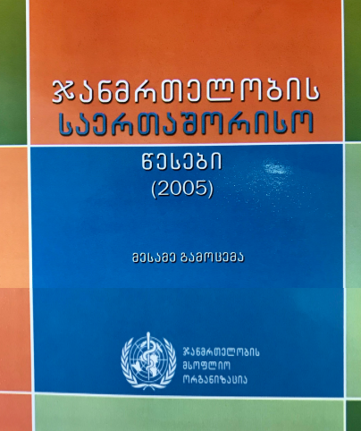
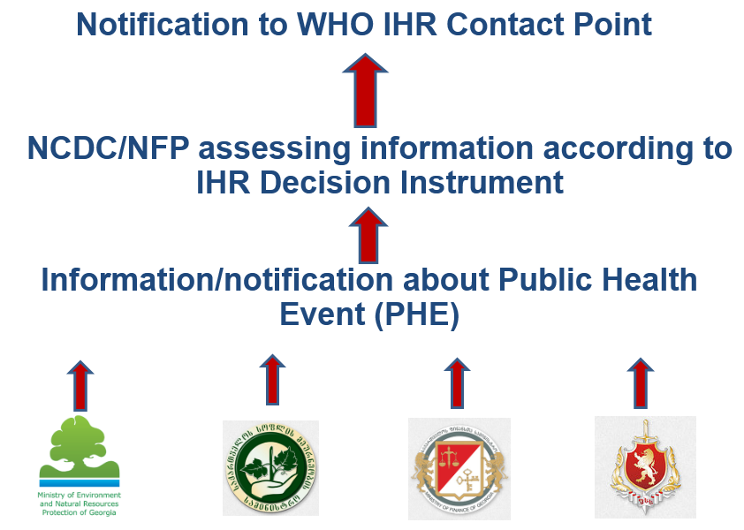
International Health Regulations
National Center for Disease Control and Public Health (NCDC) was designated as the IHR Focal Point
NFP is accessible at all times for communications with the WHO IHR Contact Points and with national surveillance and response system
24/7 Duty Officer System is at place
Communication list with contact details of all relevant institutions, organizations and persons on national, regional and local levels is prepared and updated regularly
Annual monitoring of IHR (2005) Core Capacities
Taking part in WHO project: „Voices of the Region” regarding the successful implementation of IHR in Georgia
National Center for Disease Control & Public Health
www.ncdc.ge
Notes:
37

Slide 38

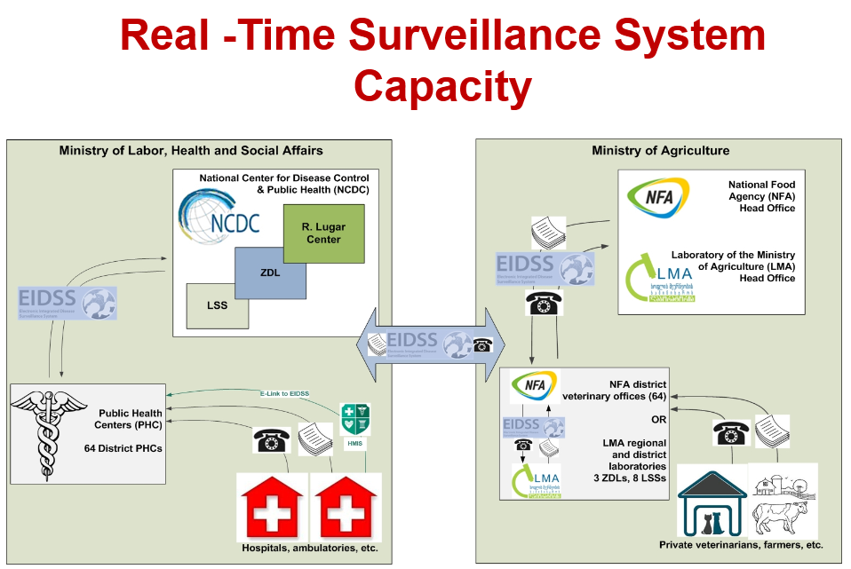
Global Health Security Agenda
National Center for Disease Control and Public Health is designated as a National coordinator of GHSA
Georgia, together with other countries is actively involved in support of the 11 Action Package objectives:
  Real-Time Surveillance - as a leading country
  National Laboratory System – as the contributing country
  Zoonotic Diseases – as the contributing country
On September 26, 2014 it was held the Global Health Security Summit in the White House, Washington DC under the US Political Leadership. On the Summit Georgia was nominated as one of the exemplary international partners
Election as the GHSA Assessment Alliance Advisory Group member
2015 - Conceptual Frame for Emergency Operation Center
“Accelerating Progress in Real-Time Surveillance Action Package of GHSA”, meeting conducted in Georgia within One Health Approach
National Center for Disease Control & Public Health
www.ncdc.ge
Notes:
38

Slide 39
GHSA Action Packages
Prevent
Antimicrobial Resistance
Zoonotic Disease – Georgia contributing
Biosafety and Biosecurity
Immunization
Detect
National laboratory System – Georgia contributing
Real-Time Surveillance – Georgia together with Norway Leading
GHSA Reporting
Workforce Development
Respond
EOC
Linking Public Health Law and Multisectoral Rapid Response
Medical Countermeasures and Personnel Deployment
National Center for Disease Control & Public Health
www.ncdc.ge

Slide 40

Public Health System Strengthening –
Future Vision
Public health
Public health and preventive medicine as a priority for the health care system development
Co-ordinated development of the public health, primary health care and the hospital sector
Public-private partnership in health care and, in particular, public health development
Large-Scale Public Movement to Healthy Georgia
Hospital sector
Primary Health Care
National Center for Disease Control and Public Health
www.ncdc.ge
Notes:
40

Slide 41
NCDC Capacity
National Center for Disease Control and Public Health
www.ncdc.ge
Notes:
41

Slide 42
NCDC
is a central public health and research institution under the authority of
Ministry of Internally Displaced Persons from the Occupied Territories, Labour, Health and Social Affairs
Established in 1996 on the basis of CDC / Atlanta
Functional Structure
Establishment of the Anti-Plague Station in Georgia
Research Center of Especially Dangerous Pathogens
1996 National Center for Disease Control
2004- As a result of large-scale reorganization: Integration of
Medical Statistics Center and Public Health Department
2013 Integration of R. Lugar Center for Public Health Research
National Center for Disease Control & Public Health
www.ncdc.ge
Notes:
42

Slide 43
Vision: Our Knowledge – for Public Health
Mission: Protection and improvement of the health of Georgia’s population through scientific evidence-based prevention of diseases, preparing for and timely responding to threats of public health
National Center for Disease Control & Public Health
www.ncdc.ge
Notes:
43

Slide 44
NCDC Strategic Priorities
Decrease of Morbidity, Disability and Mortality caused by Communicable Diseases;
Decrease of Morbidity, Disability and Mortality caused by Non-Communicable Diseases;
Assessment and correction of environmental hazards and behavioral risk-factors for improvement of health in population;
Development of applied and fundamental bio-medical and bio-technological scientific research potential;
Strengthen preparedness capacities for rapid and effective response to the public health threats;
Develop electronic information systems;
Promote development of public health care system management;
National Center for Disease Control & Public Health
www.ncdc.ge
Notes:
44

Slide 45
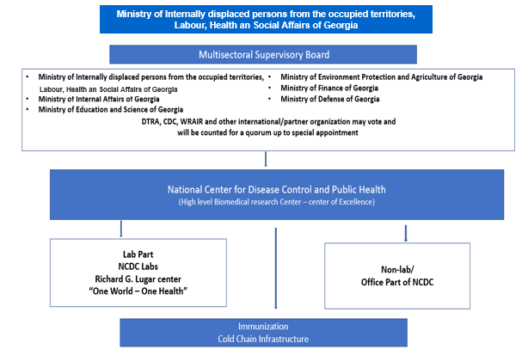
National Center for Disease Control & Public Health
www.ncdc.ge

Slide 46












WHO
CDC / Atlanta
DTRA
UNFPA
WRAIR
UNICEF
NIH
USAID
WB
NCDC
FAO / OIE
EU
GAVI ALLIANCE
Principal Recipient of GFTAM Grants
Universities, Research Centers, Public Health institutions:
University of Florida, University of Maryland,
Emory University, Johns Hopkins University, North Arizona University, Bundeswehr Institute of Microbiology, University of Oslo, The Italian National Institute of Health, German Environment Agency, Public Health England, The Arctic University of Norway etc.
Georgian National Center for Diseases Control and Public Health
www.ncdc.ge
Notes:
46

Slide 47
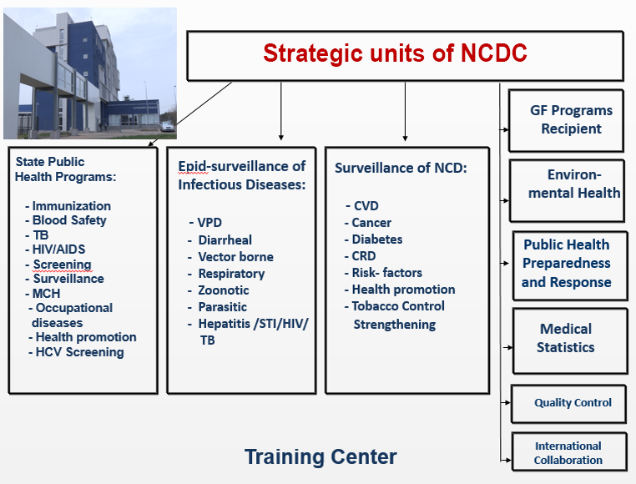
National Center for Disease Control & Public Health
National Center for Disease Control & Public Health
www.ncdc.ge
www.ncdc.ge
Notes:
47

Slide 48

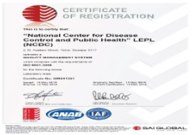

R. Lugar Center for Public Health Research
Accreditation & Certification –
NCDC / Lugar Center
Bio-safety and EDP Department
Virology, Molecular Biology and Genomic Department
  3 Labs accredited by WHO
    Polio
    Influenza
    Measles/Rubella
Bio-Safety Division
Molecular Epidemiology / Genomics
National Repository
Influenza and Respiratory Viruses Lab
5 Labs Connected to WHO Lab Network with EQA
    Rota
    Invasive Meningitis
    Malaria
    Salmonelosis
    AMR
EDP Lab
Polio and other Entero viruses lab
Zoo-Entomology Lab
Cell Culture Lab
General Bacteriology Lab
Serology Lab – HCV Research Subunit
Vivarium
Sample Receiving group
National Center for Disease Control and Public Health
www.ncdc.ge
Notes:
Fonts, mark the departments;

Slide 49
Mission and Main Functions of the Lugar Center
Country epidemiological security;
Rapid detection of biological threats and response;
Leading facility responsible for biological security;
Participation in Global Health Security Agenda (GHSA);
EDPs consolidated in a secure place;
Zoo-entomological Surveillance;
დაავადებათა კონტროლისა და საზოგადოებრივი ჯანმრთელობის ეროვნული ცენტრი
National Center for Disease Control & Public Health
www.ncdc.ge
www.ncdc.ge
Notes:
49

Slide 50
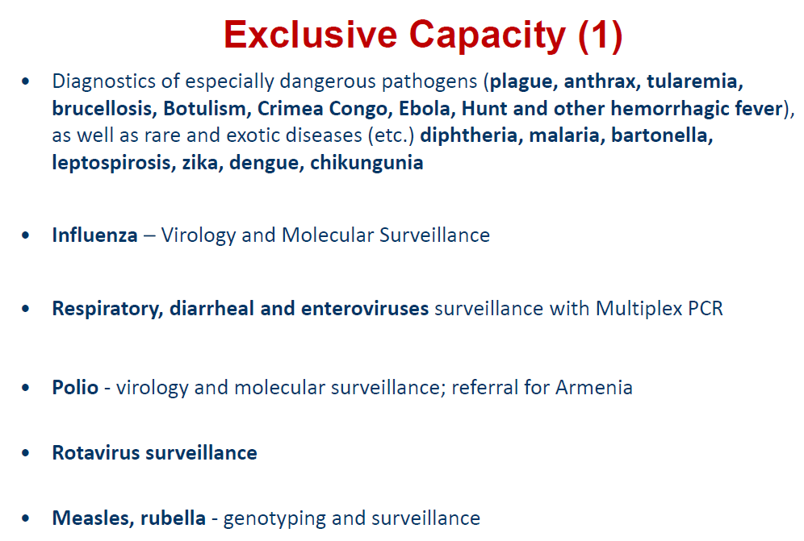
დაავადებათა კონტროლისა და საზოგადოებრივი ჯანმრთელობის ეროვნული ცენტრი
National Center for Disease Control & Public Health
www.ncdc.ge
www.ncdc.ge
Notes:
50

Slide 51
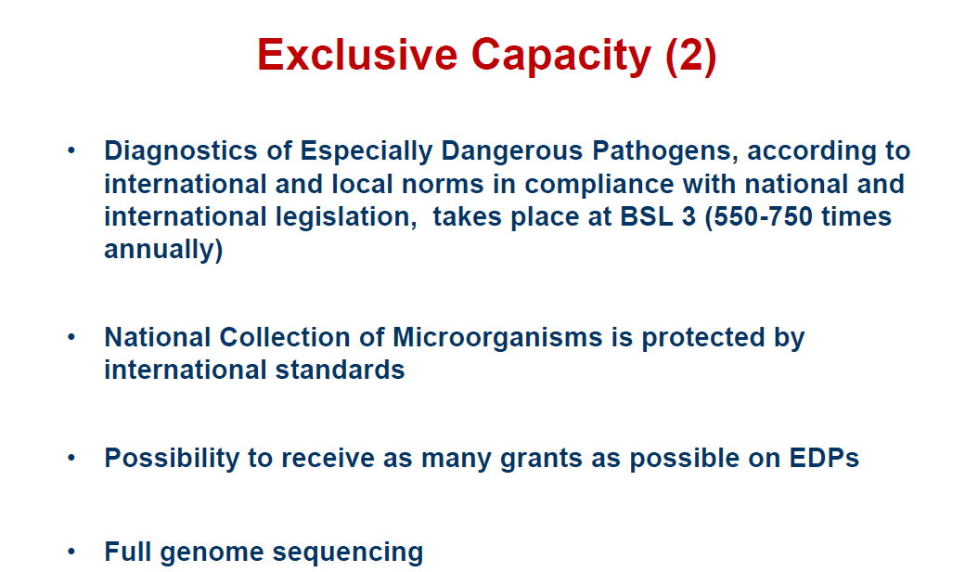
დაავადებათა კონტროლისა და საზოგადოებრივი ჯანმრთელობის ეროვნული ცენტრი
National Center for Disease Control & Public Health
www.ncdc.ge
www.ncdc.ge
Notes:
51

Slide 52
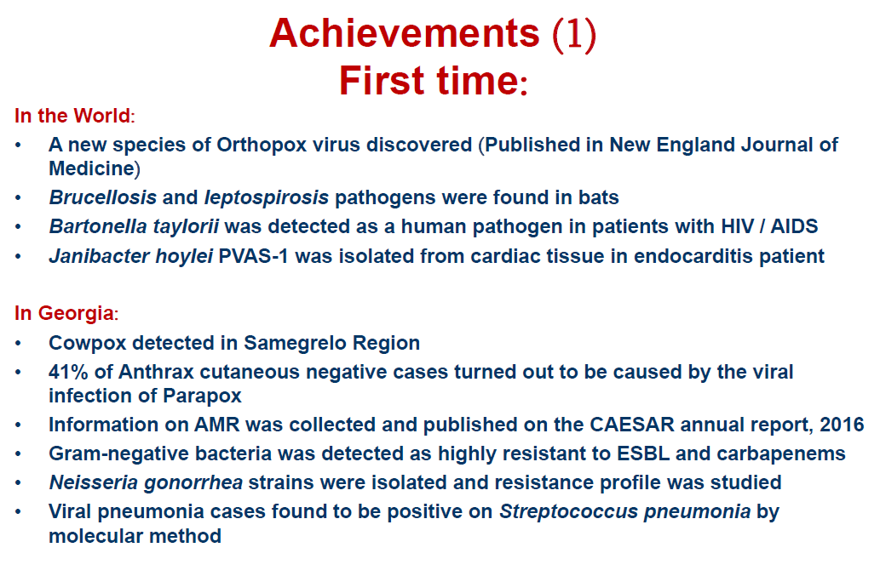
დაავადებათა კონტროლისა და საზოგადოებრივი ჯანმრთელობის ეროვნული ცენტრი
National Center for Disease Control & Public Health
www.ncdc.ge
www.ncdc.ge
Notes:
52

Slide 53
Achievements (2)
First time:
In Georgia
Active anthrax soil foci increased up to 15% (10% historically). Correspondingly increased the risk of disease, in animals as well as in humans
New tularemia foci was detected in Kvemo Kartli region
Cases of tularemia were detected in West Georgia, Imereti region
Cl. Dificille was isolated from clinical samples
Leptospirosis species were identified in the country
Escherichia coli (STEC) toxigenic markers (stx1/stx2/eae/Ehly) were identified
Data of the genetic profiles of Salmonella spp., Shigella spp. and Escherichia coli (STEC) by the pulsed field gel electrophoresis (PFGE) were obtained and interpreted in Pulsnet (National database was established for Shigella sonnei, E.coli 0157, E.coli non 0157, Shigella flexneri and Salmonella at NCDC)
Sequencing of measles/rubella was introduced. Study revealed measles genotype – D8
New serotypes of Salmonella and Shigella were found from clinical samples
Through GAPR (Genetic Algorithm for Rule-set Production) it became possible to forecast and perform ecological niche modelling of vectors; GIS database started to be developed
National Center for Disease Control and Public Health
www.ncdc.ge
Notes:
53

Slide 54
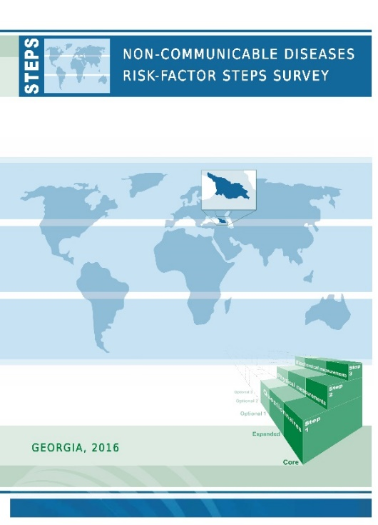

Non-communicable Diseases Surveillance
NCDs and Risk-factors Surveillance
  Routine statistics
  Registries – cancer registry, birth registry
  EIDSS
  Sentinel surveillance - „Strengthening of micronutrients deficiency surveillance systems” Collaborative Project / CDC USA – NCDC Georgia
  STEPS 2010 and STEPS 2016
  Other surveys
    GeRHS, GNNS, GYTS, COSI, HBSC, ESPAD, Hep C survey, Iodine survey…
Health Promotion State Program
  Tobacco, Alcohol, Nutrition, Physical activity, Mental Health, Drug abuse, Hepatitis C, Environmental Health, Health promotion
Health educational activities
Tobacco Control Strengthening
National Center for Disease Control & Public Health

Slide 55





Multiple Indicator Cluster Survey (MICS)
Lead Prevalence (%)
≥5 μg/dL and ≥10 μg/dL lead Prevalence (%)
National Center for Disease Control & Public Health

Slide 56
Multiple Indicator Cluster Survey (MICS)
Mean lead concentration (μg/dL)
Median lead concentration (μg/dL)
National Center for Disease Control & Public Health

Slide 57
State Response
Immediate response
6 children (with BLL≥30 μg/dL) and members of their families were tested (NCDC, pediatrician, National Environment Agency)
Based on recommendations of the US Centers for Disease Control and Prevention and American Academy of Pediatrics, the Ministry of Health approved clinical protocol of Early Identification of Toxic Effect of Lead in Children and Management Measures which aims at prevention of harmful effect of lead, timely identification of lead level alleviation and efficient management of cases.
Long-term strategic response
Government’s vision on environmental policy – “Green Economy” strategy
  Key focus of green policy – protection of environment to improve ecology and preserve natural resources for future generations.
  Two priorities: (1) eradicate bitter legacy and (2) use unique wealth of the country and in the nearest future to achieve the results facilitating positioning of Georgia as a country with Green Economy.
„National Environmental Health Action Plan 2018-2022 NEHAP 2“,approved by the Government of Georgia on December 29, 2018 by resolution No. 680
March 26 - Environmental Health Action Plan (NEHAP2) Inter-sectoral Coordination Council Meeting under the leadership of the Prime Minister where various agencies were given relevant assignments.
On April 19 the Government of Georgia issued an Order (N--) on “Early Identification of Toxic Effect of Lead in Children and Management Measures “.
Amendment envisaging addition and development of lead component to the Resolution No. 693 of December 2018 of the Government of Georgia on the Approval of 2019 Health Protection State Programmes has been prepared
National Center for Disease Control & Public Health

Slide 58
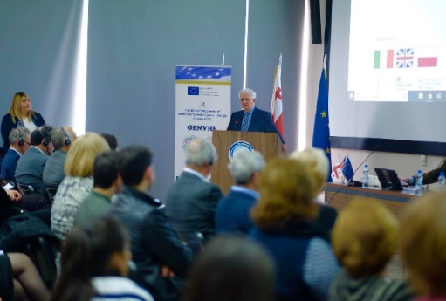

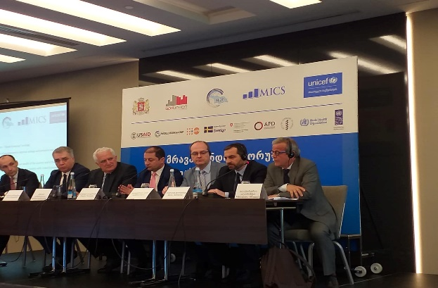


Environmental Health
National Environmental Health Action Plan 2018-2022 (NEHAP-2) adopted by the Government of Georgia in December 2018. NCDC is responsible for coordination of the implementation of the Action Plan
Established National Coordination council, which will be the advisory
body of Georgian government and is headed by the Prime Minister
of Georgia
With EU technical and financial support, NCDC implemented
Twinning project “Strengthening of Environmental Health
System in Georgia” in 2017-2019
UBA/WHO project-Legislative and Action Framework for collecting and sharing information on Hazardous Chemical Substances in Georgia
3 publications were published in collaboration with WHO
Multiple Indicator Cluster Surveys (MICS) survey carried out in
Georgia by UNICEF, Geostat and NCDC
National Center for Disease Control & Public Health
www.ncdc.ge
Notes:
58

Slide 59

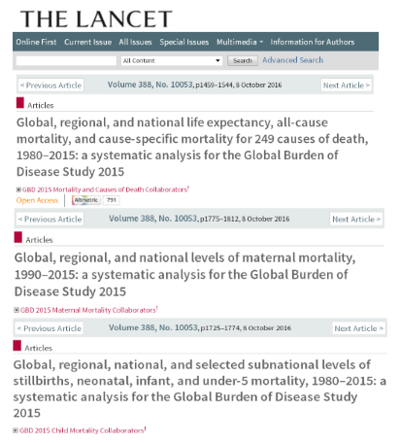
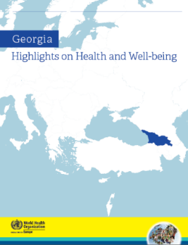
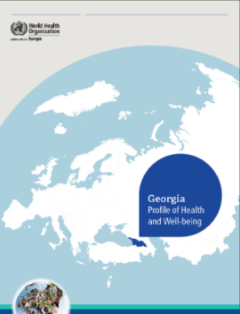

Medical Statistics
  Routine Statistical data
  Case-based electronic reporting system for primary health care facilities and hospitals
  Population-based Cancer Registry; Analysis of three year data of Cancer Population Registry (2015-2017)
  Birth registry
  Birth / death registration electronic program
  Determination of morbidity trends, calculation of health indicators and its submission to the state and international level
  New electronic platform of existed reporting forms
  Collaboration with the Institute for Health Metrics and Evaluation (IHME) at the University of Washington
  Statistical yearbooks “Health Care in Georgia” in Georgian and English and other publications
  Data for Health for All and Human resources Data bases were provided
National Center for Disease Control & Public Health
www.ncdc.ge
Notes:
59

Slide 60
Various activities in 2018
71 different scientific programs/projects/grants were carried out in 2018 at the Center
20 PhD thesis have been elaborated by the NCDC staff for obtaining PhD degree.
18 research articles, 66 abstracts, 69 various publications and 8 epidemiological bulletins were published in 2018 by the employees of the Center
Data used in the 3 articles, published in the journal "The Lancet" underwent expertise by NCDC Staff
127 employees of the center participated in international conferences, symposia, congresses etc.
66 specialist were trained in international trainings
85 specialists got the internship in 2018 at the Center
18 presentations were submitted on various international events
8 MoUs were signed with international collaborators
National Center for Disease Control and Public Health
www.ncdc.ge
Notes:
60

Slide 61
2018 Consolidated Budget Actual Performance
National Center for Disease Control & Public Health
www.ncdc.ge
Notes:
61

Slide 62
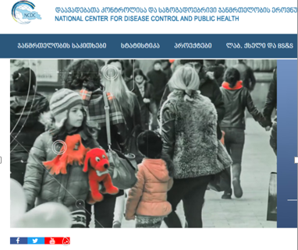
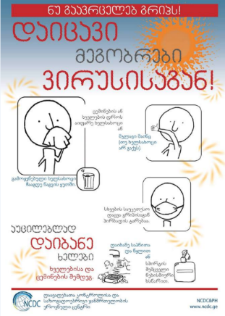
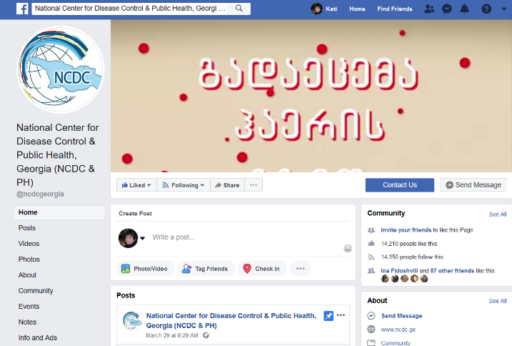


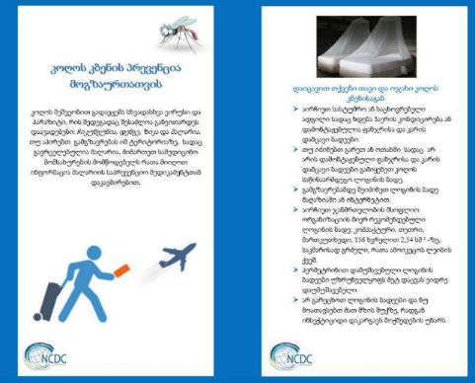
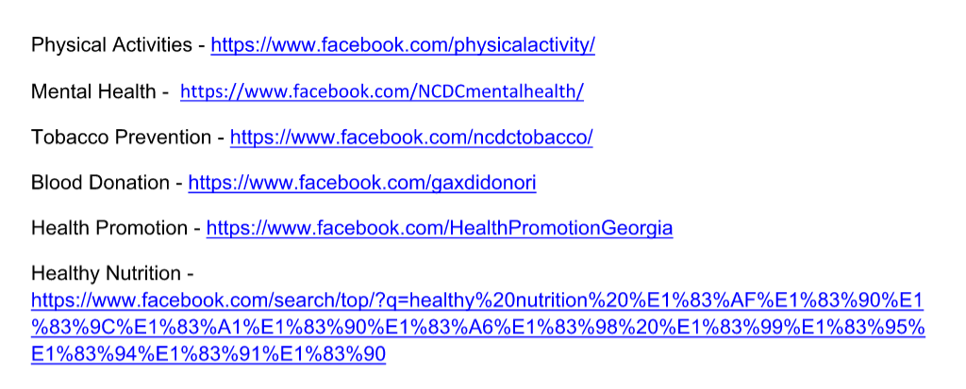
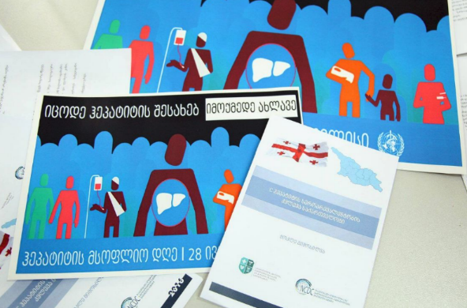
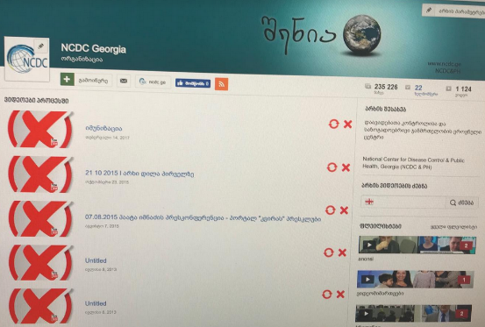
www.ncdc.ge
https://www.facebook.com/?ref=tn_tnmn
https://www.facebook.com/ncdcgeorgia/?ref=settings
https://twitter.com/NCDCGeorgia
https://www.myvideo.ge/?user_id=1177176
https://www.youtube.com/channel/UCFvFld1amAvavTAMth05ffw?view_as=subscriber
დაავადებათა კონტროლისა და საზოგადოებრივი ჯანმრთელობის ეროვნული ცენტრი
www.ncdc.ge

Slide 63
Thank you!
National Center for Disease Control & Public Health
National Center for Disease Control & Public Health
www.ncdc.ge
www.ncdc.ge

